Slide 1
Websites!
with Grady

Slide 2
Websites are SUPER useful!
They can be used for…
Google
Youtube
Spotify
KhanAcademy
..and more!

Slide 3
What are websites made out of?
Code!
HTML
CSS
JavaScript

Slide 4
HTML
The STUFF
What your site SAYS and HAS
Headers, paragraphs, images, etc.
Each of these things is called an ELEMENT
Elements are represented by TAGS

Slide 5
HTML is all about tags!
<body> - where all of your stuff will go!
<h1> - the largest header possible
<h2> - slightly smaller header
<p> - paragraph (normal sized text)
<i> - italic text
<img> - image
<a> - anchor (a link)
<b> - bold text
<div> - division (an area of content)
<head> - header (basically a type of div)
<ol> - ordered list (1, 2, 3)
<ul> - unordered list
<hr> - horizontal rule (a line)
<title> - the name in the tab

Slide 6

Our first website
Open this program:

Slide 7
Our first website
<!DOCTYPE html>
<html>
<h1>Hello world!</h1>
</html>

Slide 8
Our first website
Opening the site:
Right-click on the file.
Click on Open with
Click on Google Chrome (or another browser of you choice)

Slide 9
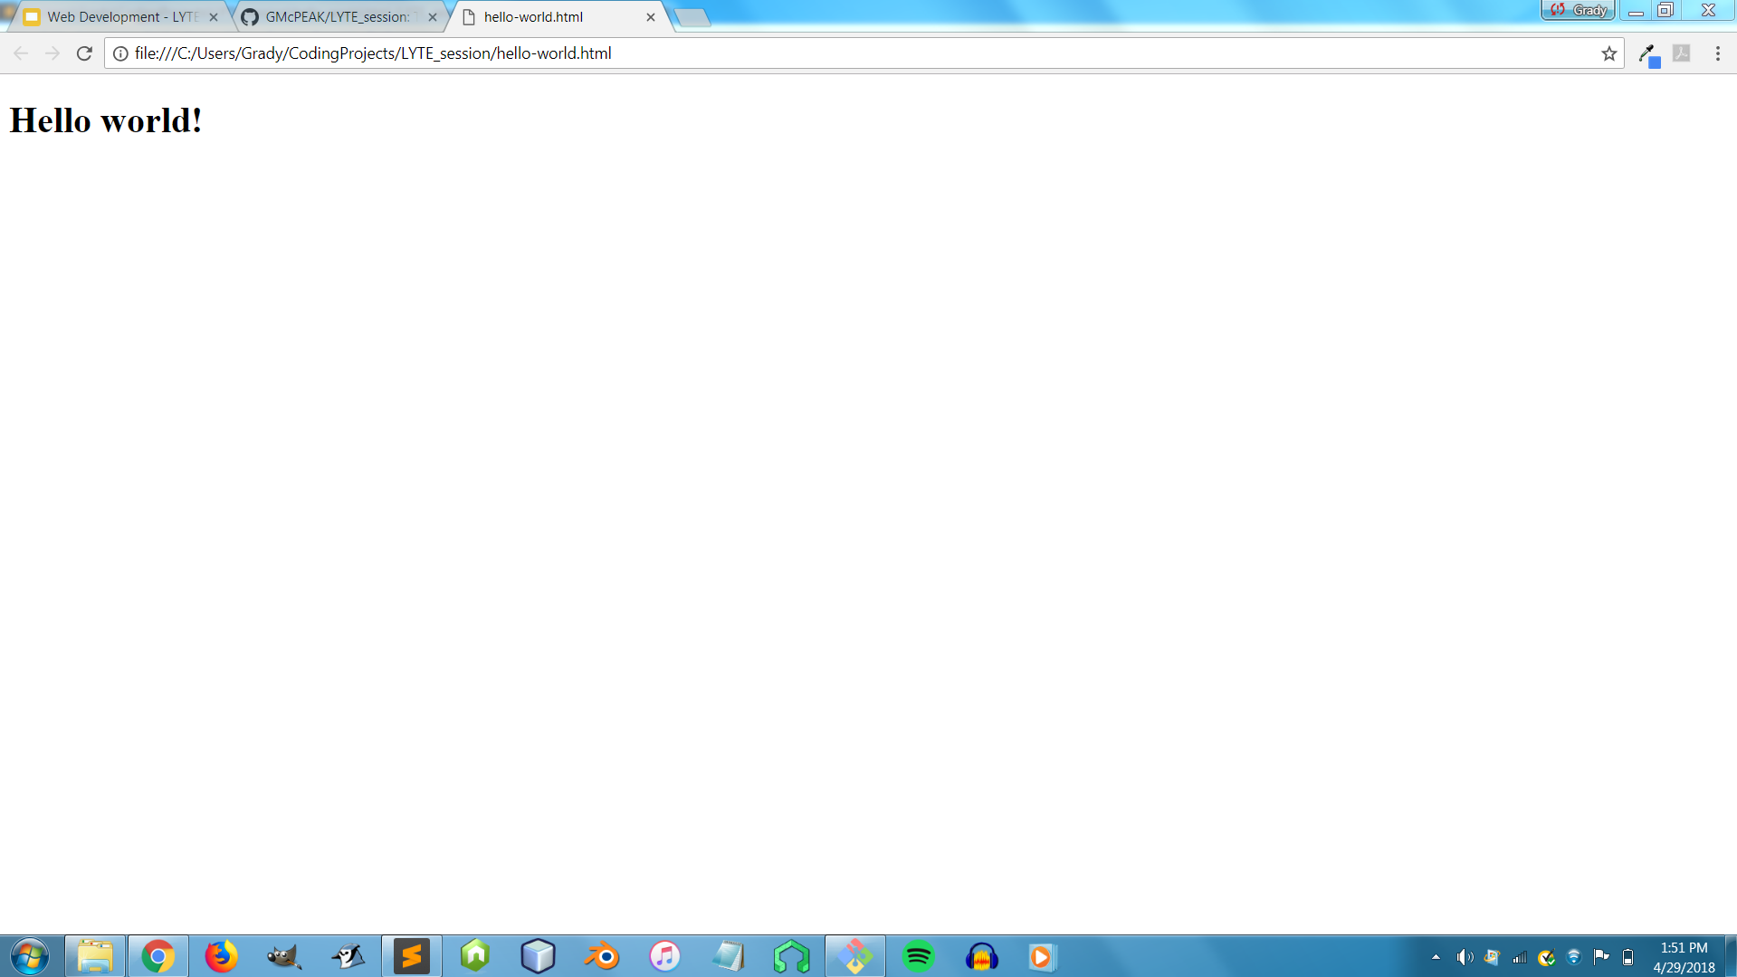
Our first website
Should look like this:

Slide 10
Our second website
<!DOCTYPE html>
<html>
<div>
<h1>Hello world (again)!</h1>
<h2>This is a smaller header</h2>
</div>
<div>
<p>This is a paragraph. Horizontal rule incoming!</p>
<hr>
<p>And this is <b>bold</b> and this is <i>italics</i></p>
</div>
</html>

Slide 11
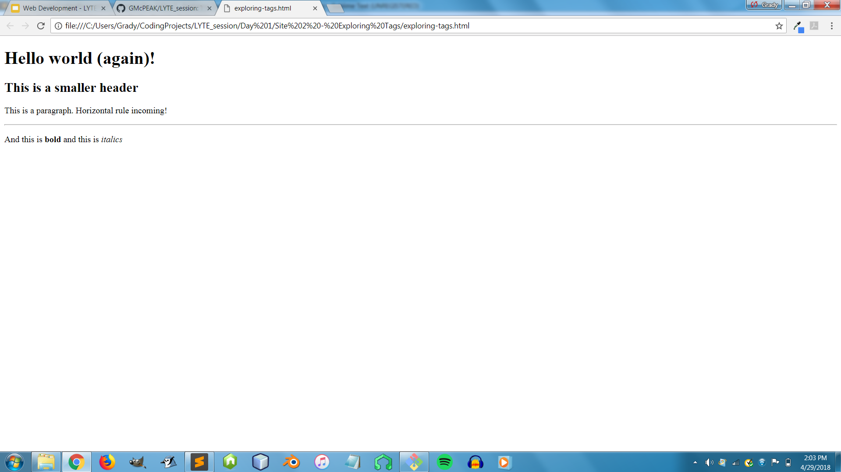
Our second website
Should look like this:

Slide 12
<a> + <img>
How to do a link:
Use an attribute called href, and src
Here’s an example:
<a href="https://www.google.com/">Google</a>
And another...
<img src = "https://upload.wikimedia.org/wikipedia/en/4/46/Waluigi.png"></img>

Slide 13
Our third website
<!DOCTYPE html>
<html>
<div>
<h1>Hello world (again)!</h1>
<h2>This is a smaller header</h2>
</div>
<div>
<p>This is a paragraph. Horizontal rule incoming!</p>
<hr>
<p>And this is <b>bold</b> and this is <i>italics</i></p>
</div>
<div>
<p>Here's a link:</p>
<a href="https://www.google.com/">Google</a>
</div>
<div>
<p>Here's an image:</p>
<img src = "https://upload.wikimedia.org/wikipedia/en/4/46/Waluigi.png"></img>
</div>
</html>

Slide 14
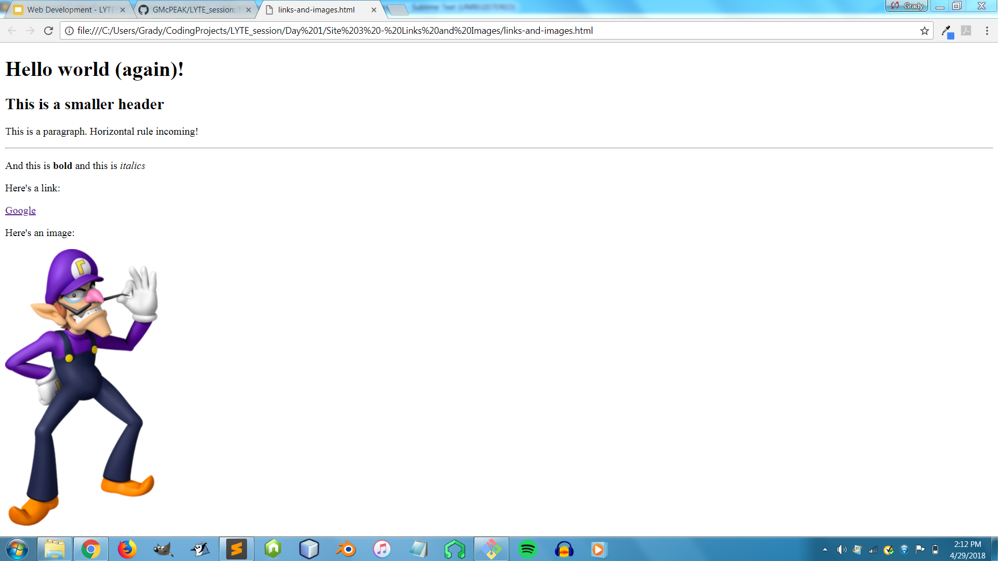
Our third website
Should look like this:

Slide 15

Resources
All webpages, slide shows, and images from these lessons can be found on a website called GitHub.
You can find all this stuff at https://github.com/GMcPEAK/LYTE-Lessons

